Slide 1
ScRNA seq –hOM project
Feroze
2020-04-15

Slide 2
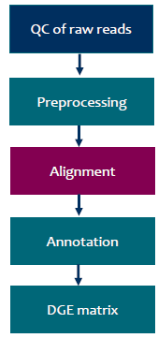
scRNA-seq data analysis steps for producing a digital gene expression matrix (DGE) followed by Seurat v3.0
10X chromium pipeline
•Check the quality of sequencing reads
•Trim if necessary
•Align to reference genome
•Match the alignment positions to known locations of genes
•Count reads/UMIs for each gene
•Store UMI counts in a table
•And now we are ready for the interesting stuff…

Slide 3
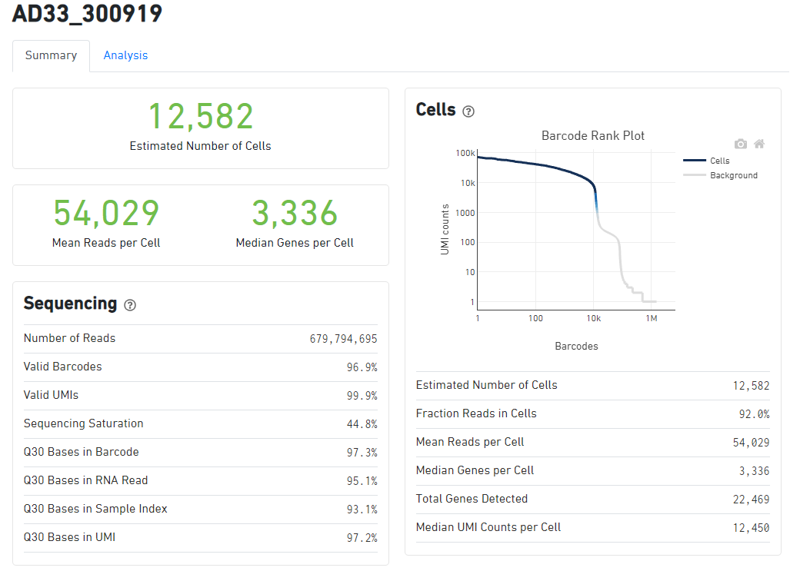
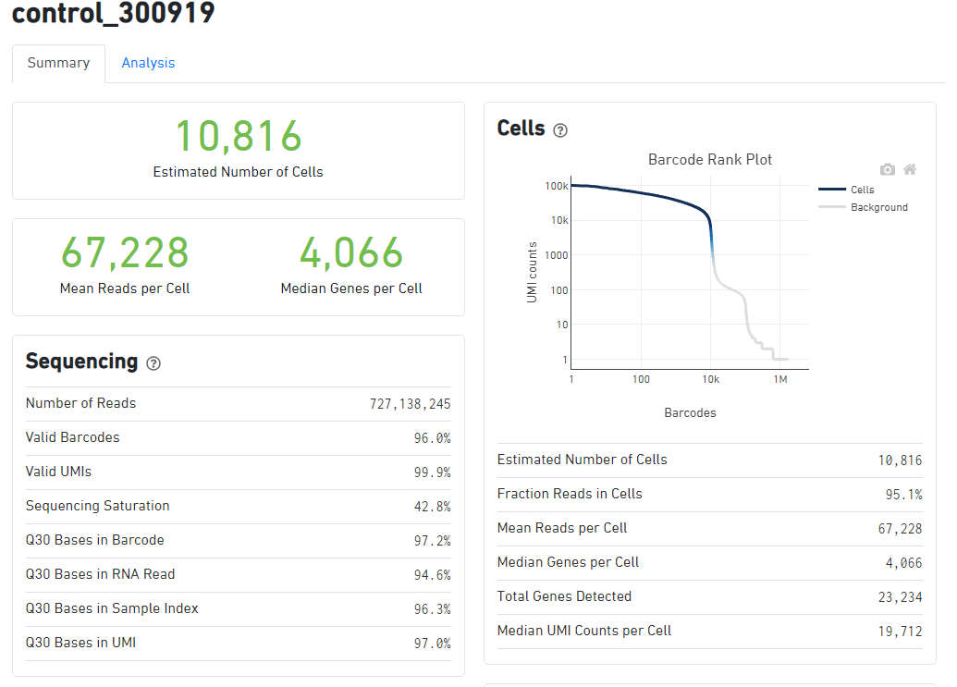
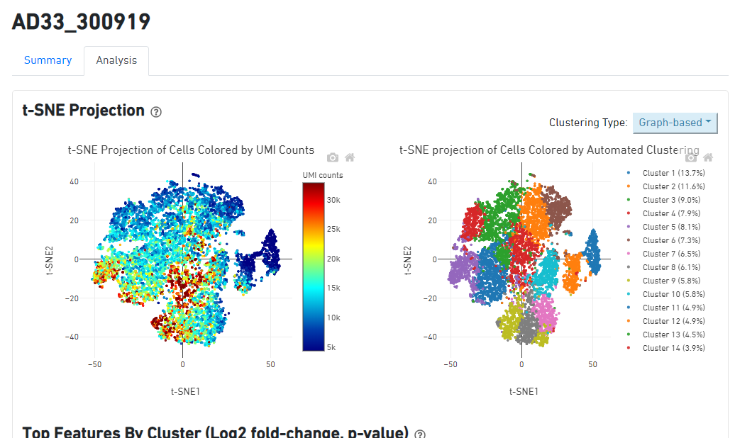
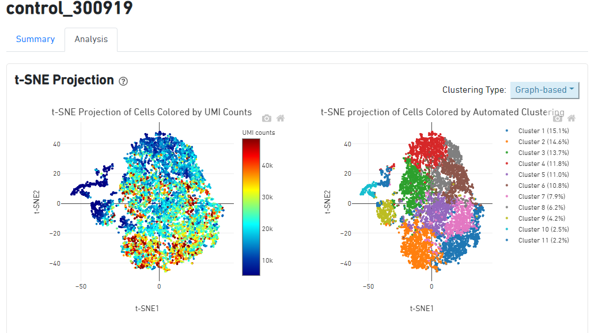

Slide 4
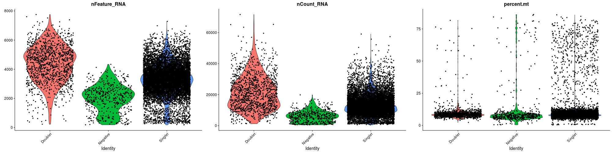
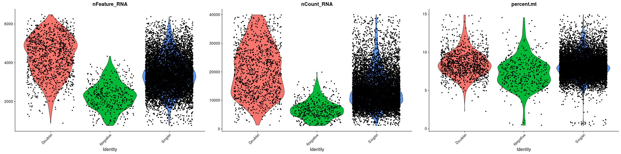
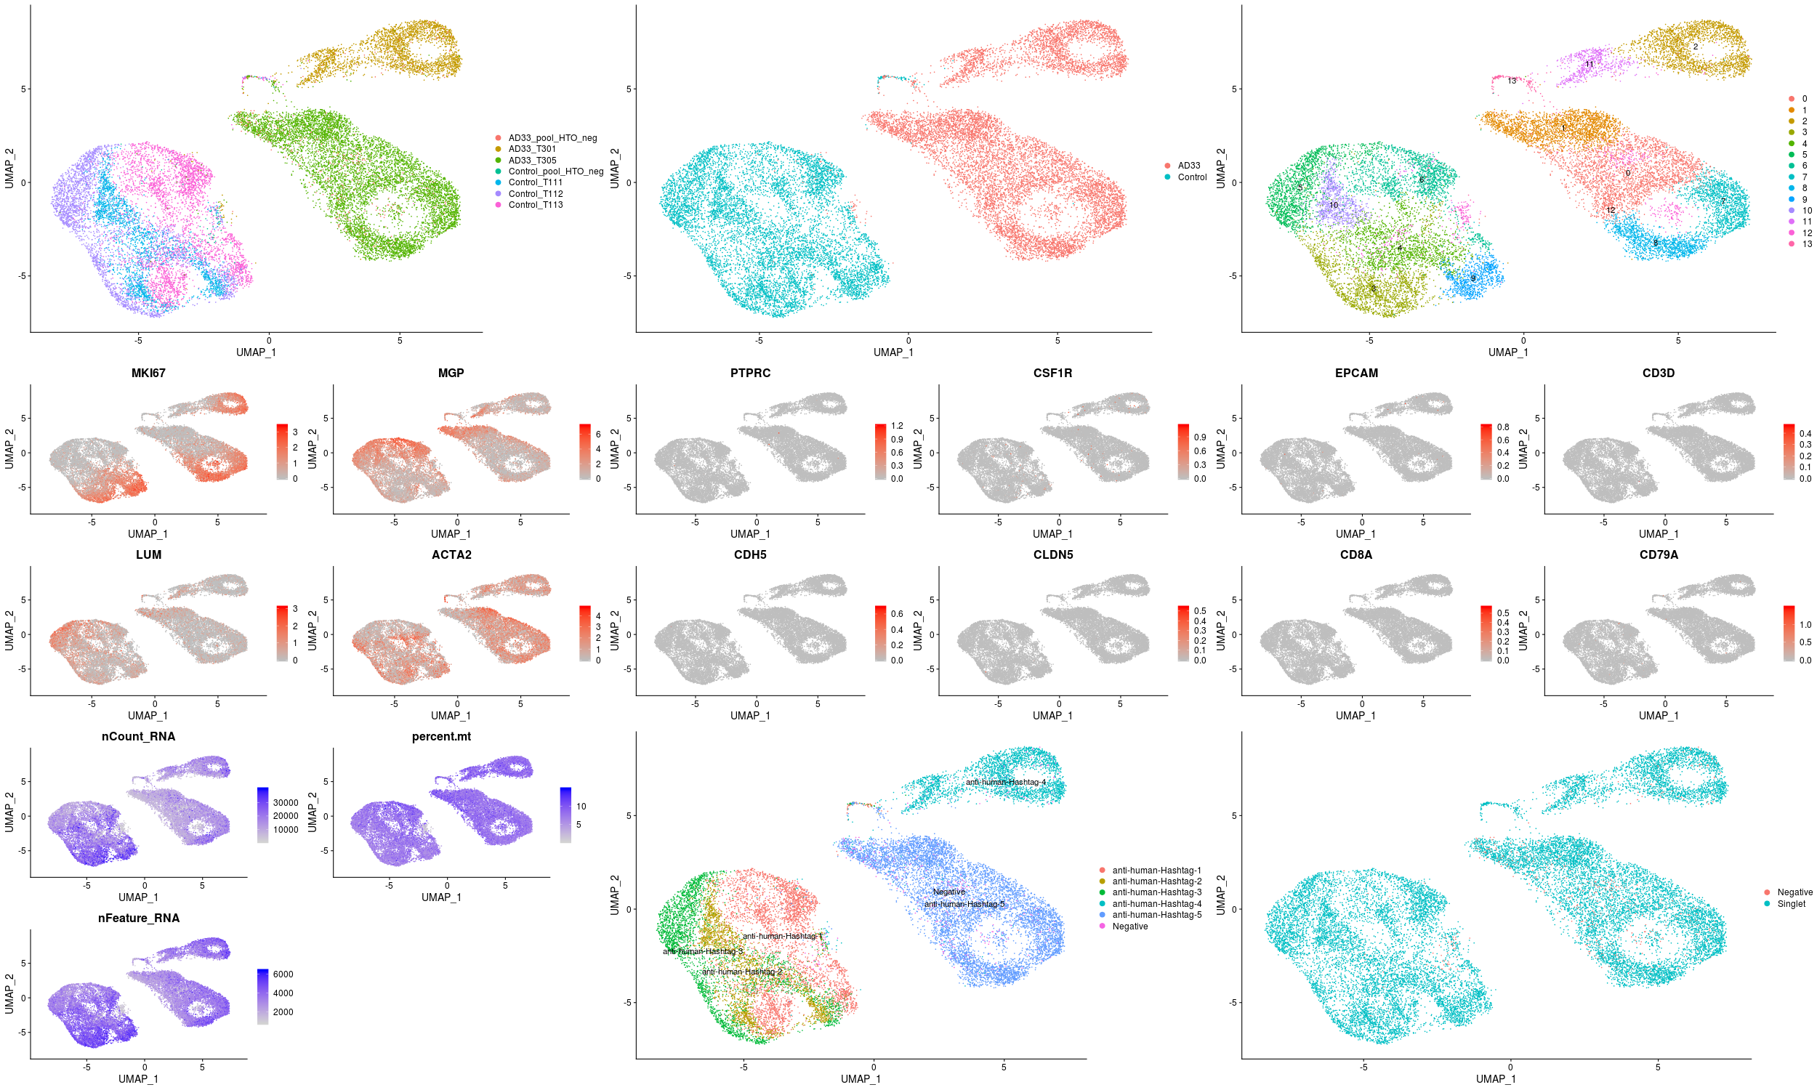
Quality control of cells and their marker genes before filtering
Quality control of cells and their marker genes after filtering
Control-AD33 merged cells UMAP-clusters samples and QC

Slide 5

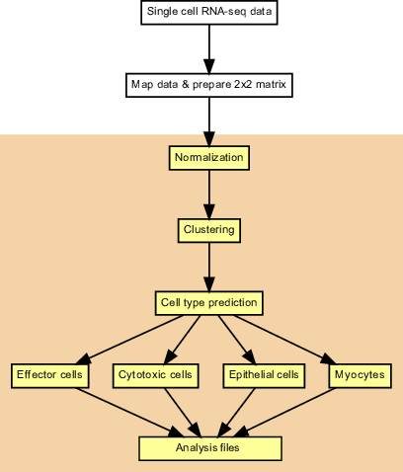
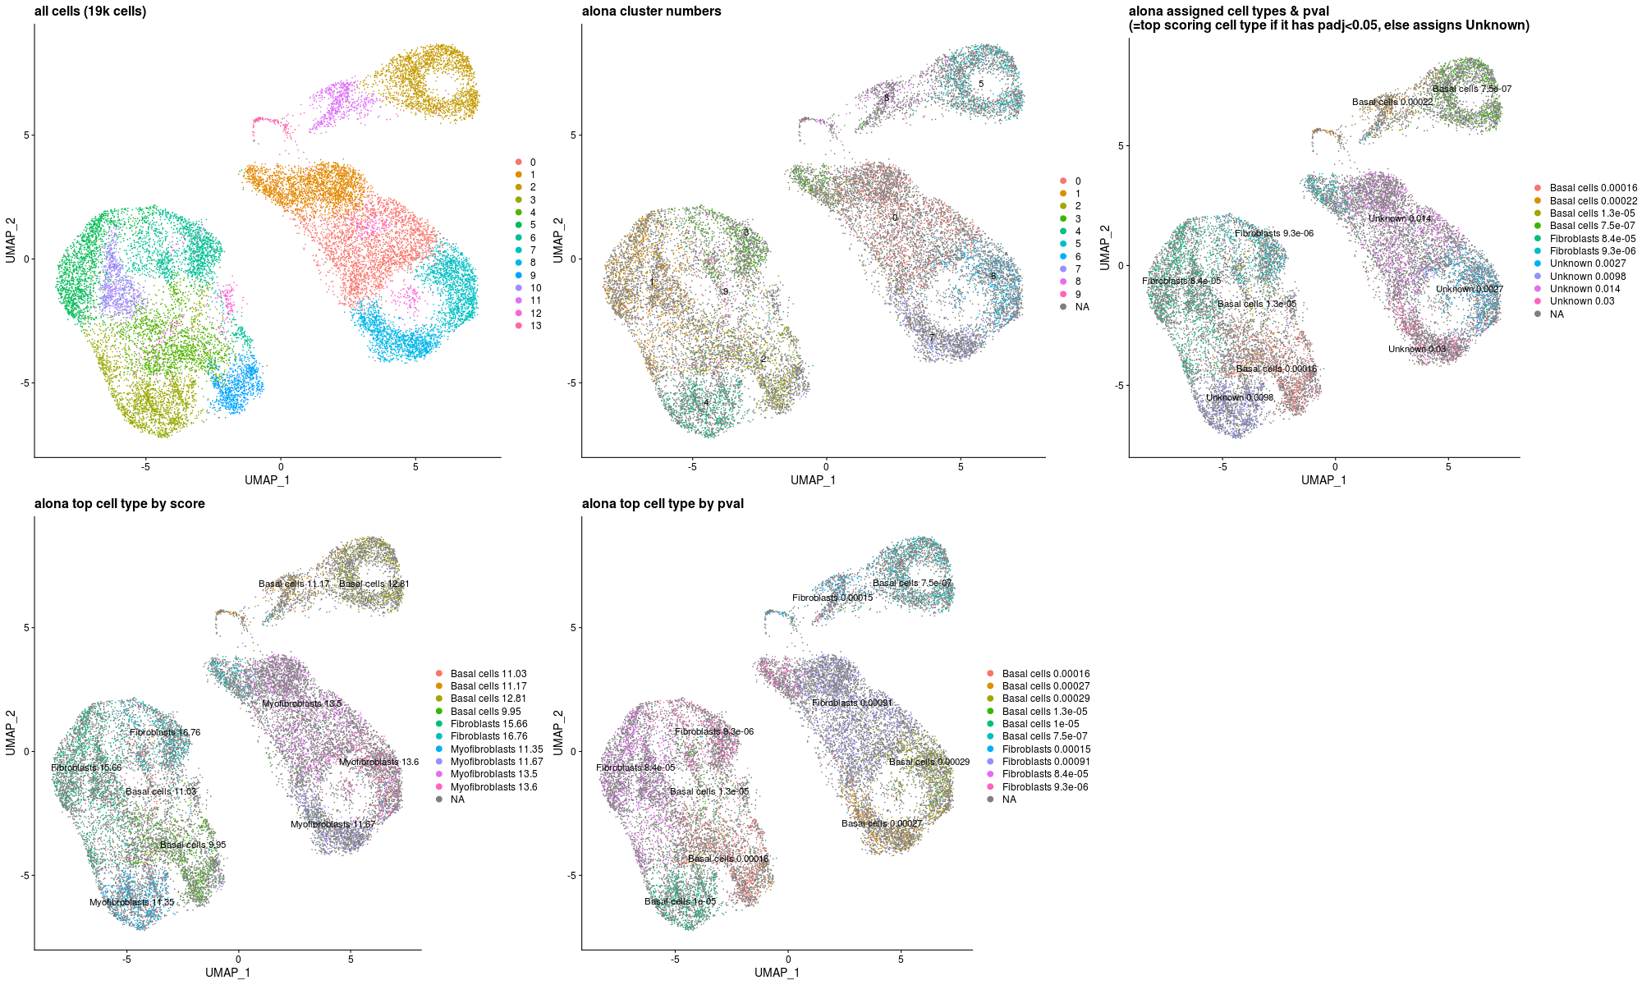
alona performs advanced visualization, processing and cell type prediction from scRNA-seq using machine learning models to achieve accurate inference of biological cell types
Control-AD33 merged downsample 5K cells for cells predicition-UMAP

Slide 6
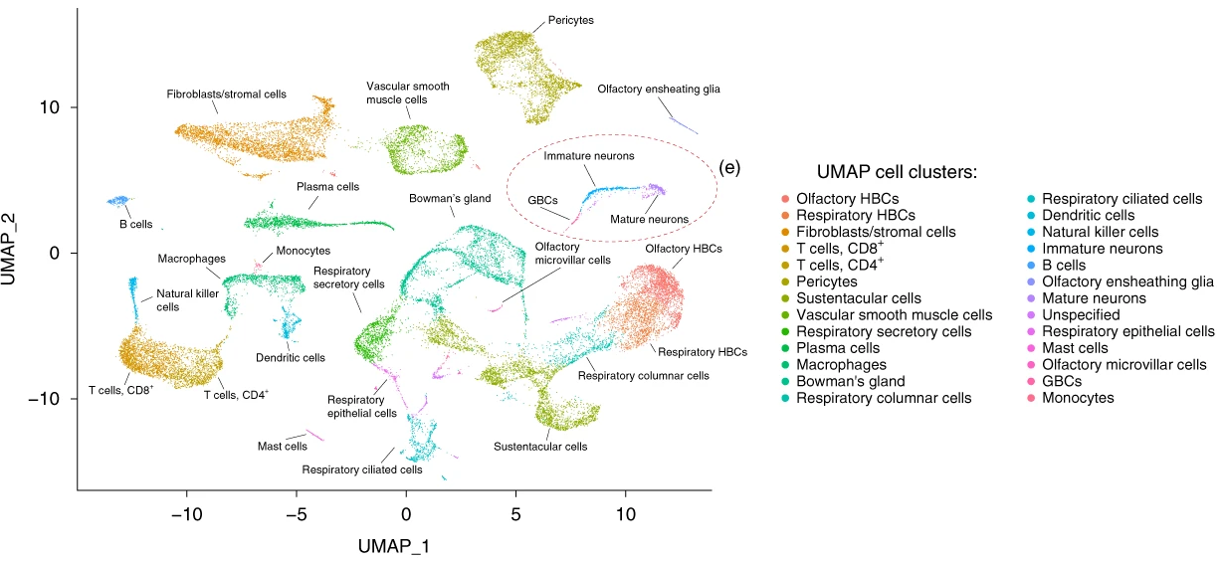
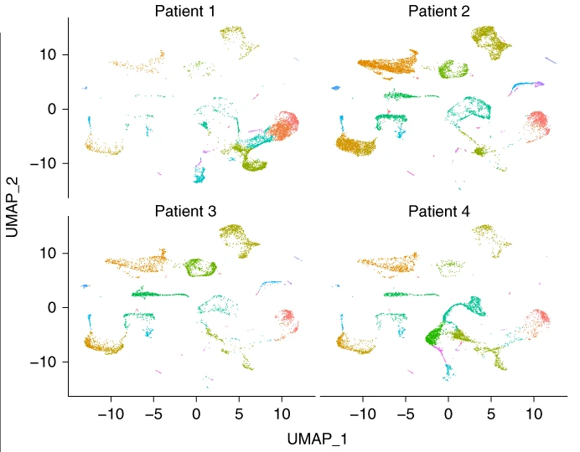
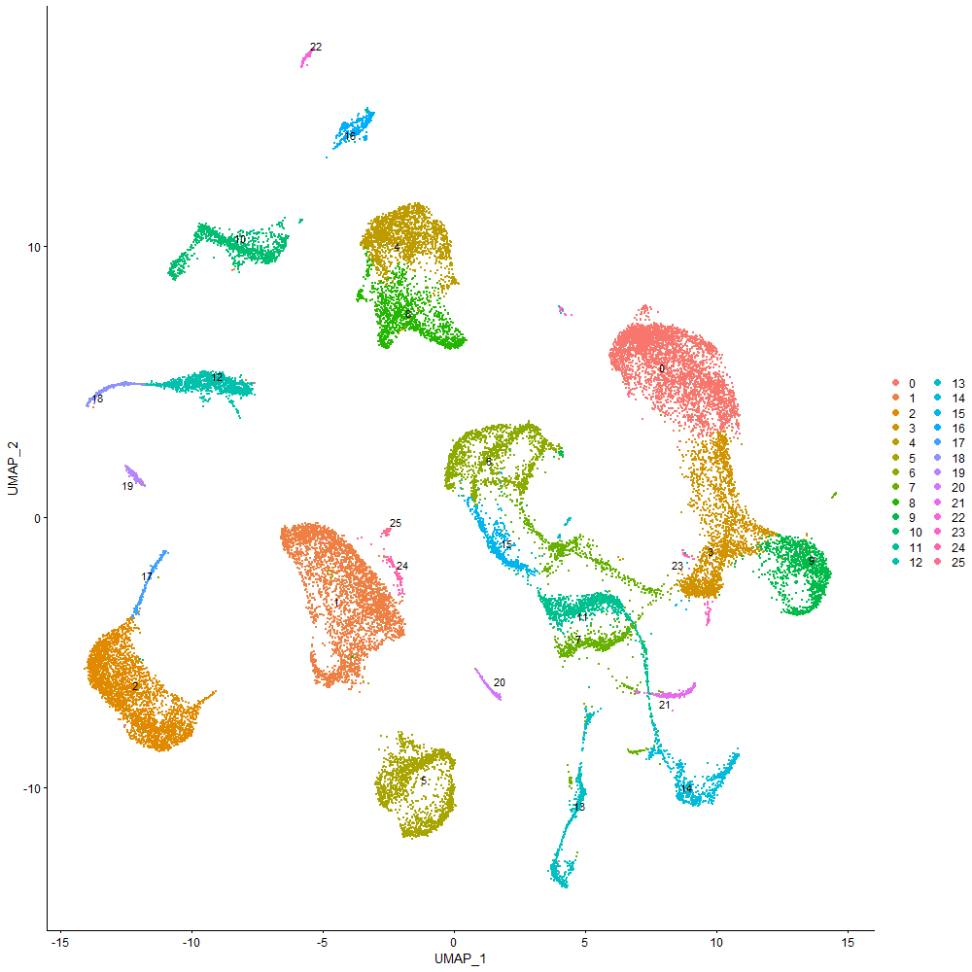
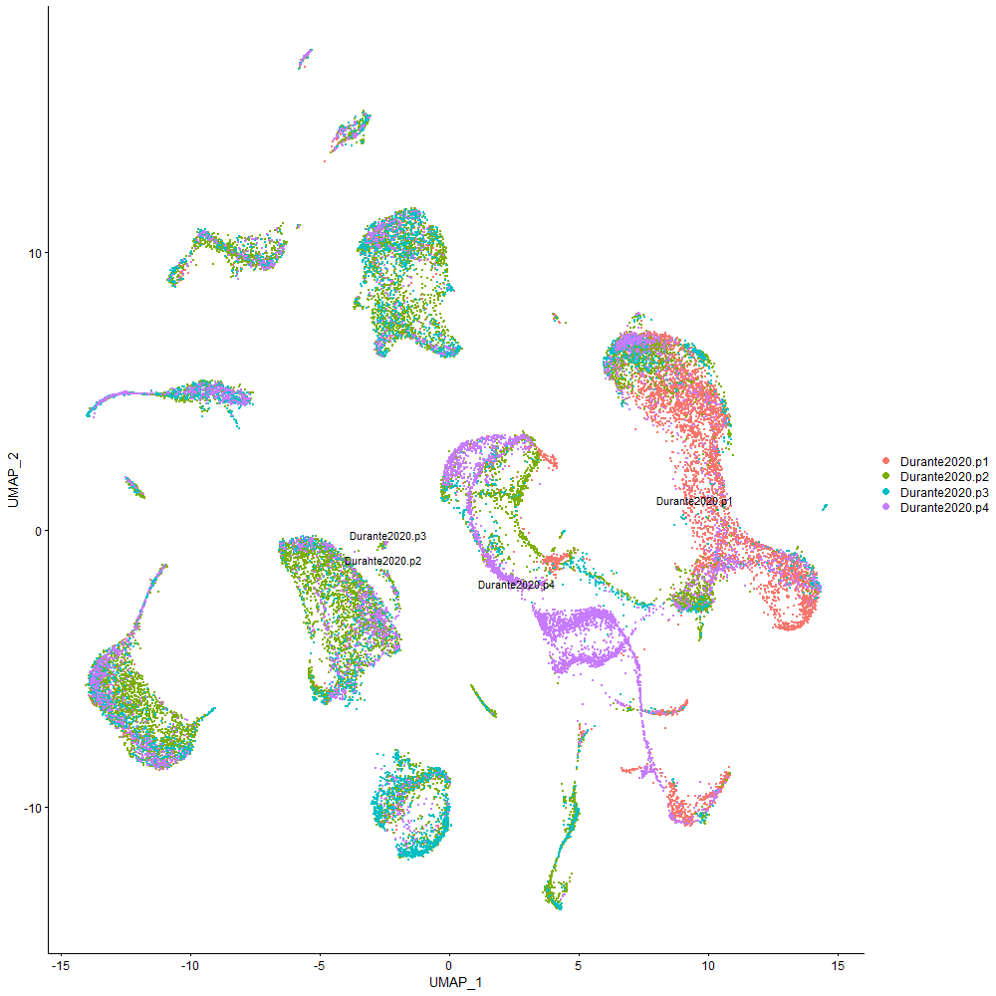
Setting up the hOM in vivo scRNA-Seq data published by Durante et al 2020
Source data: Durante et al 2020 hOM in vivo scRNA-Seq from 4 donors
Need to load and preprocess the raw count matrices
Following the author’s data processing protocol as much as possible
The UMAP won’t not look exactly the same; this is typical for reprocessing data
UMAP-s from their paper:
(Some patient-specific clusters are evident)
My UMAP from reprocessing the Durante2020 data
Similar general clustering pattern; similarly, some clusters originate from mostly a single donor

Slide 7
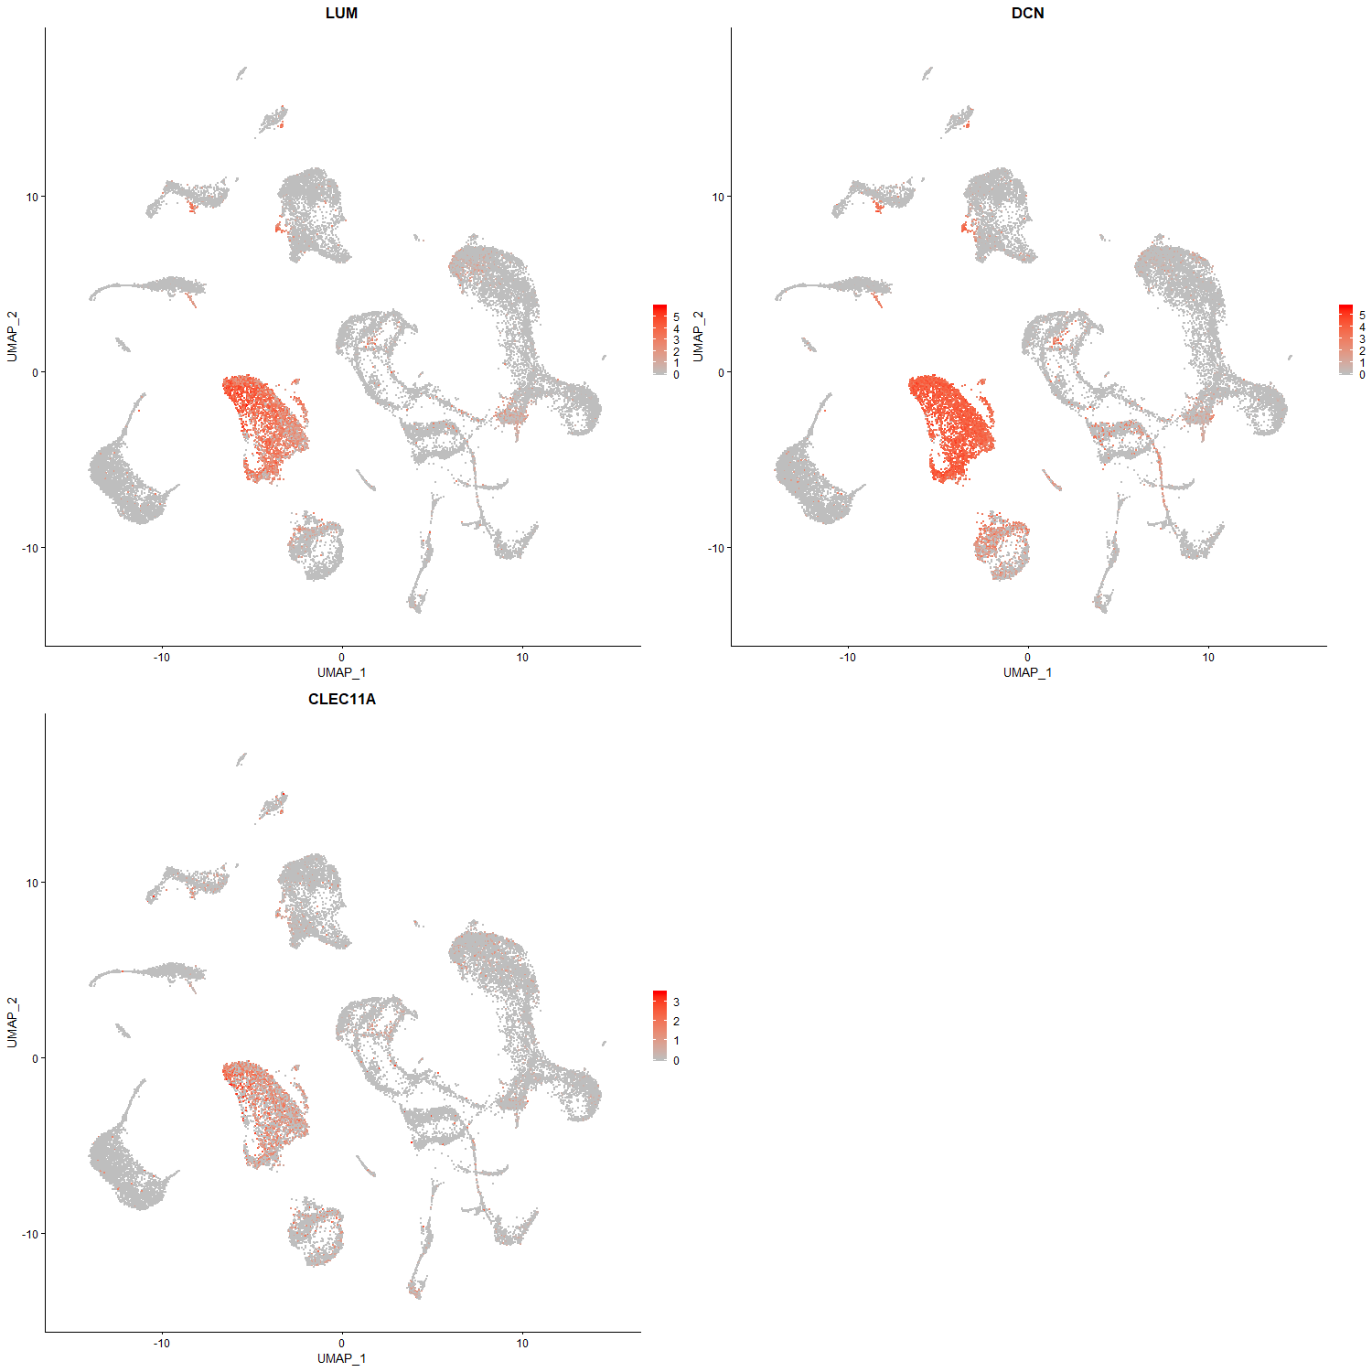
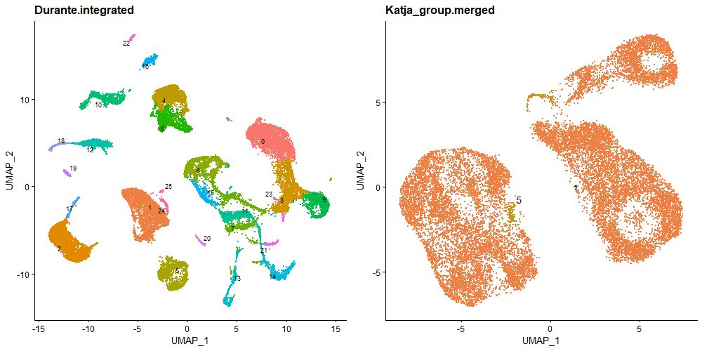
Identification of „fibroblast/stromal cells“ as cluster 1
Markers used by Durante et al 2020 to identify Fibroblast/stromal cells (stated in their Methods):
Cell type prediction using the in vivo reference (Durante 2020 data)
Using cell cycle regress-out for this
The Katja_group cells get predicted as cluster 1 („FB/stromal cell“); a few also as cluster 5 (SMC), probably related to the myofibroblast-like component of these transcriptomes
Note: for a final figure, should switch numbers to cell type names

Slide 8
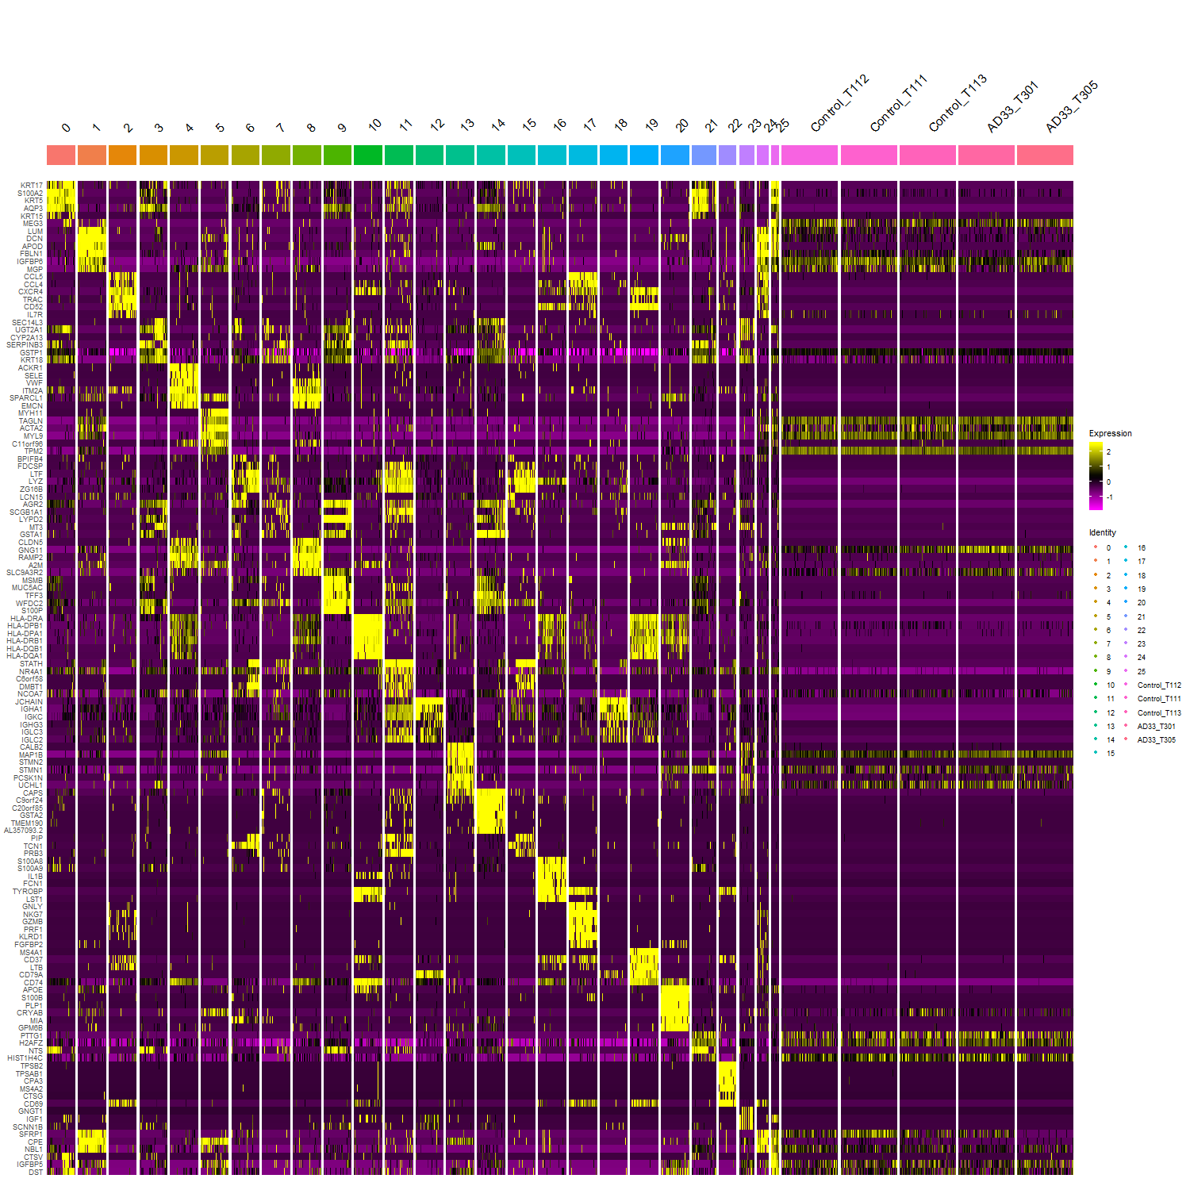
Plot the top cluster markers from in vivo to see which clusters the in vitro cells share markers with
The in vitro cells express markers of:
Cluster 1 (FB/stromal)
Cluster 5 (SMC)
Cluster 8 (Pericytes)
Cell cycle genes (Cluster 13 and 21)
Some likely doublet clusters (cluster 24 and 25)
➔ fibrogenic and myocyte-related cells
➔ in general agreement with
cell type prediction from in vivo reference
the Alona automated cell type prediction tool
In vivo cell clusters

Slide 9
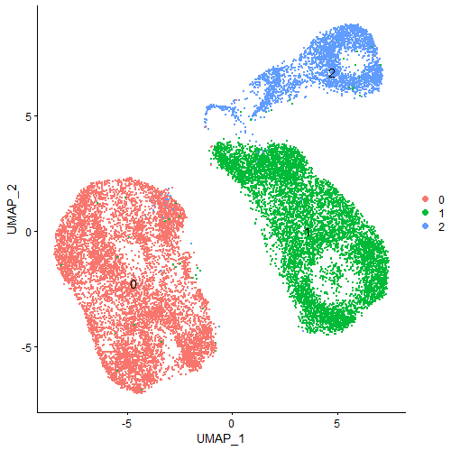
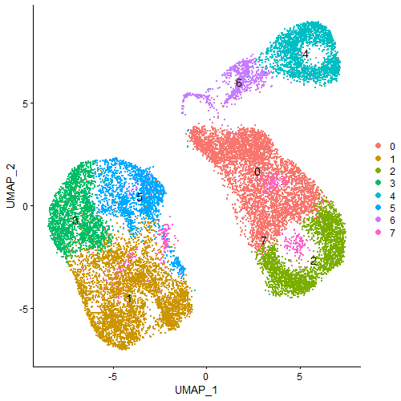
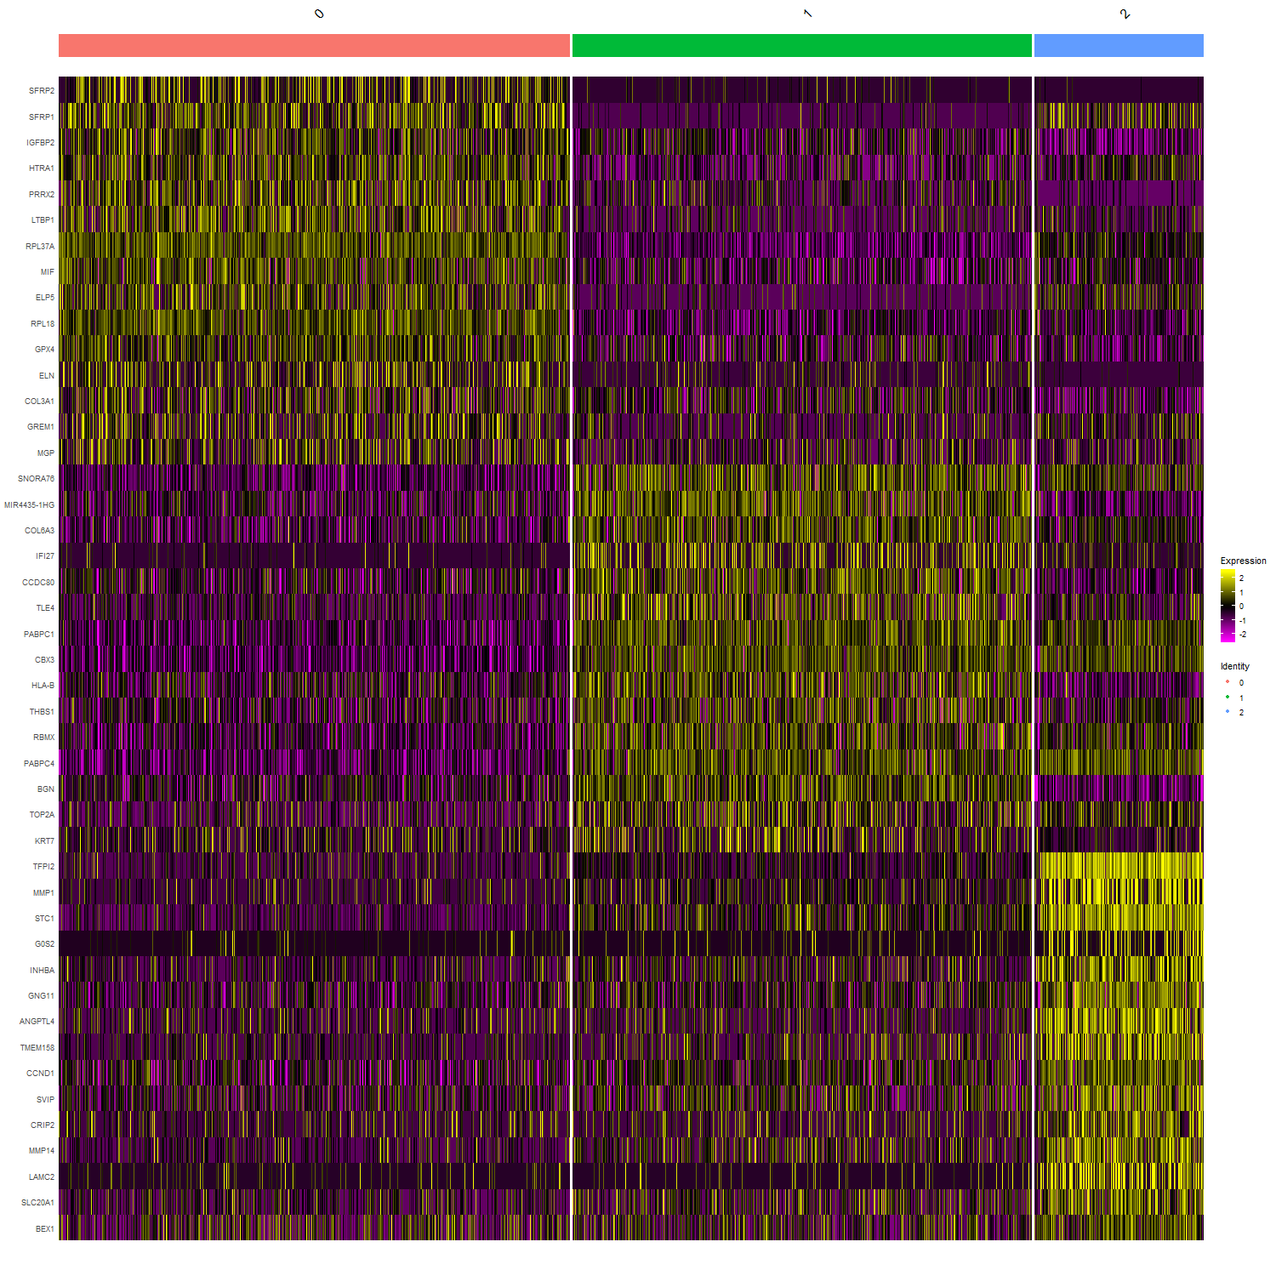
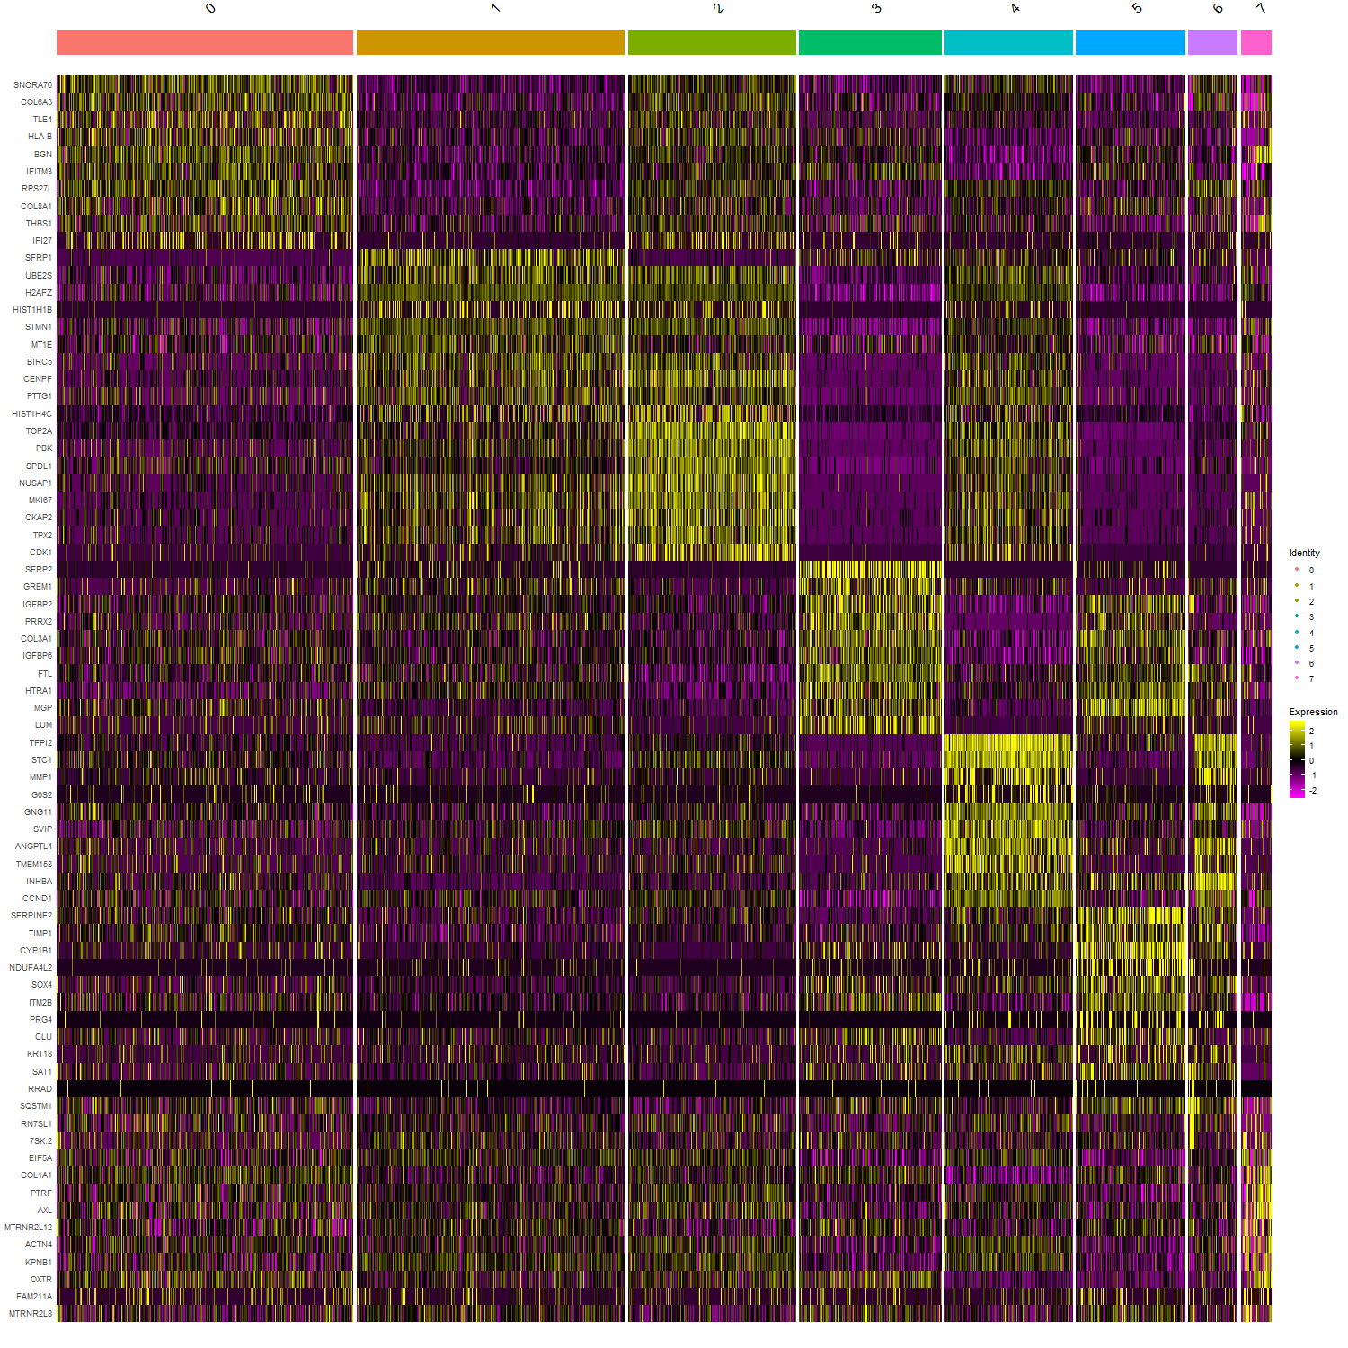
Two clustering resolutions for the in vitro cells:
3 clusters (resolution 0.05):
Each main ‘island’ becomes a separate cluster
8 clusters (resolution 0.25):
Within each main ‘island’, the principal separation is by cell cycle phase
Evaluate the biological justification of the clustering
3 clusters (resolution 0.05):
Clusters are well supported by specific markers
8 clusters (resolution 0.25):
Clusters are reasonbly well supported
(mostly c1, c2 and c4 share markers; they are all the S+G2M cells)

Slide 10
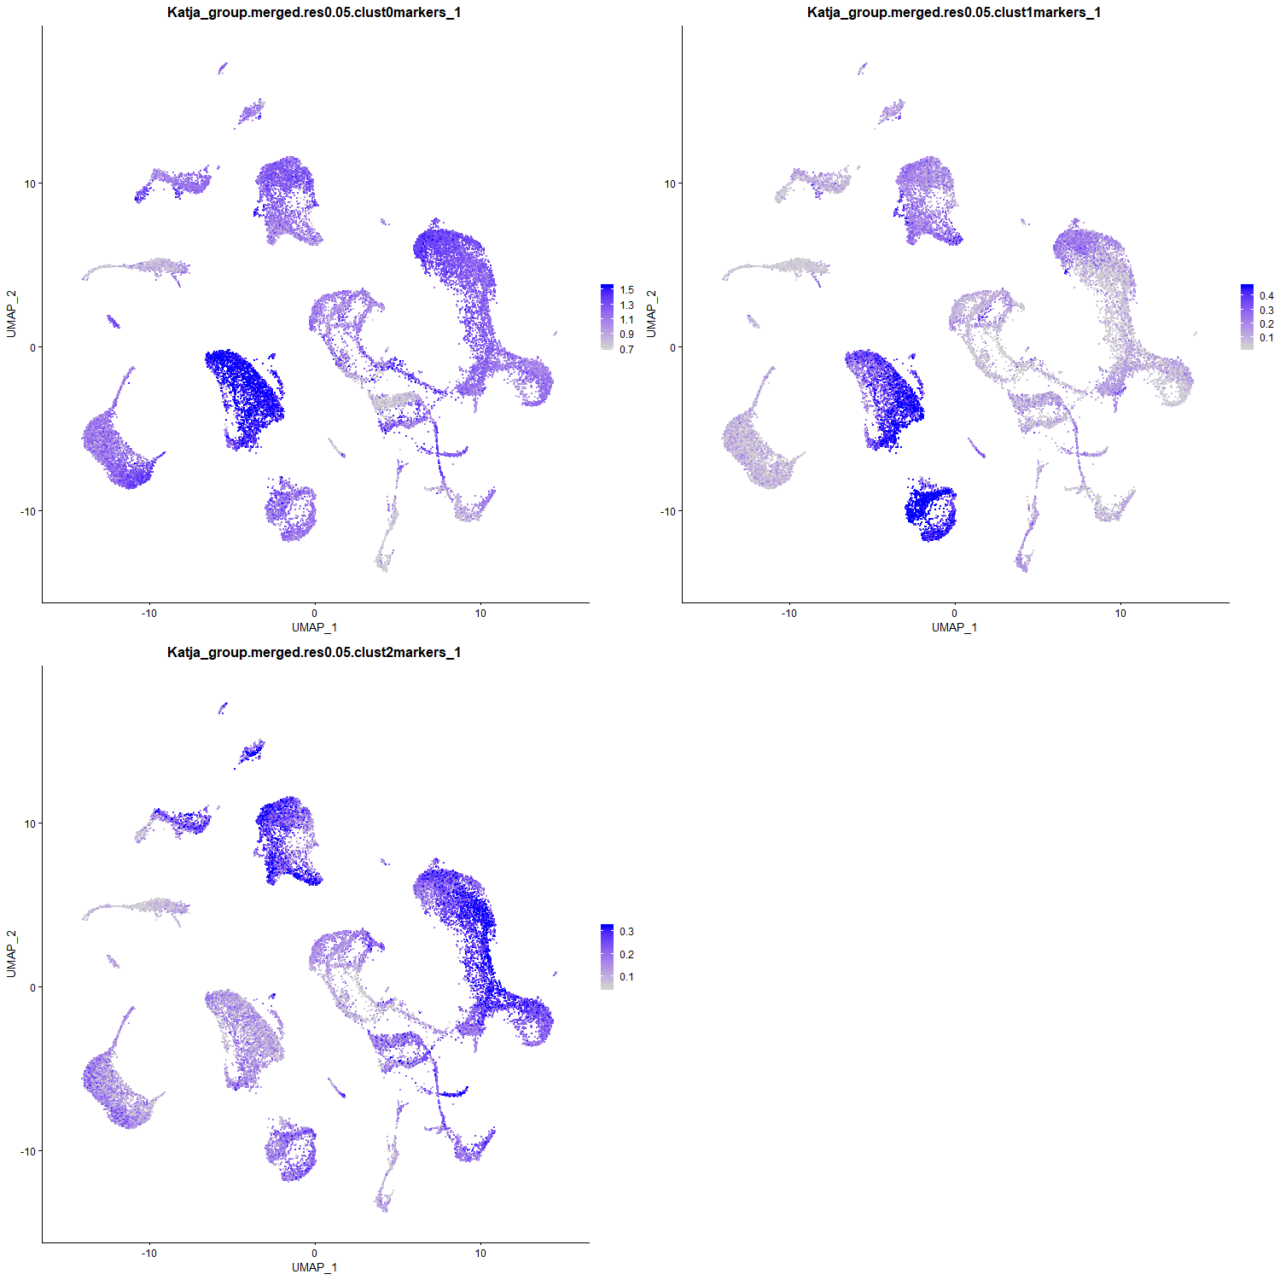
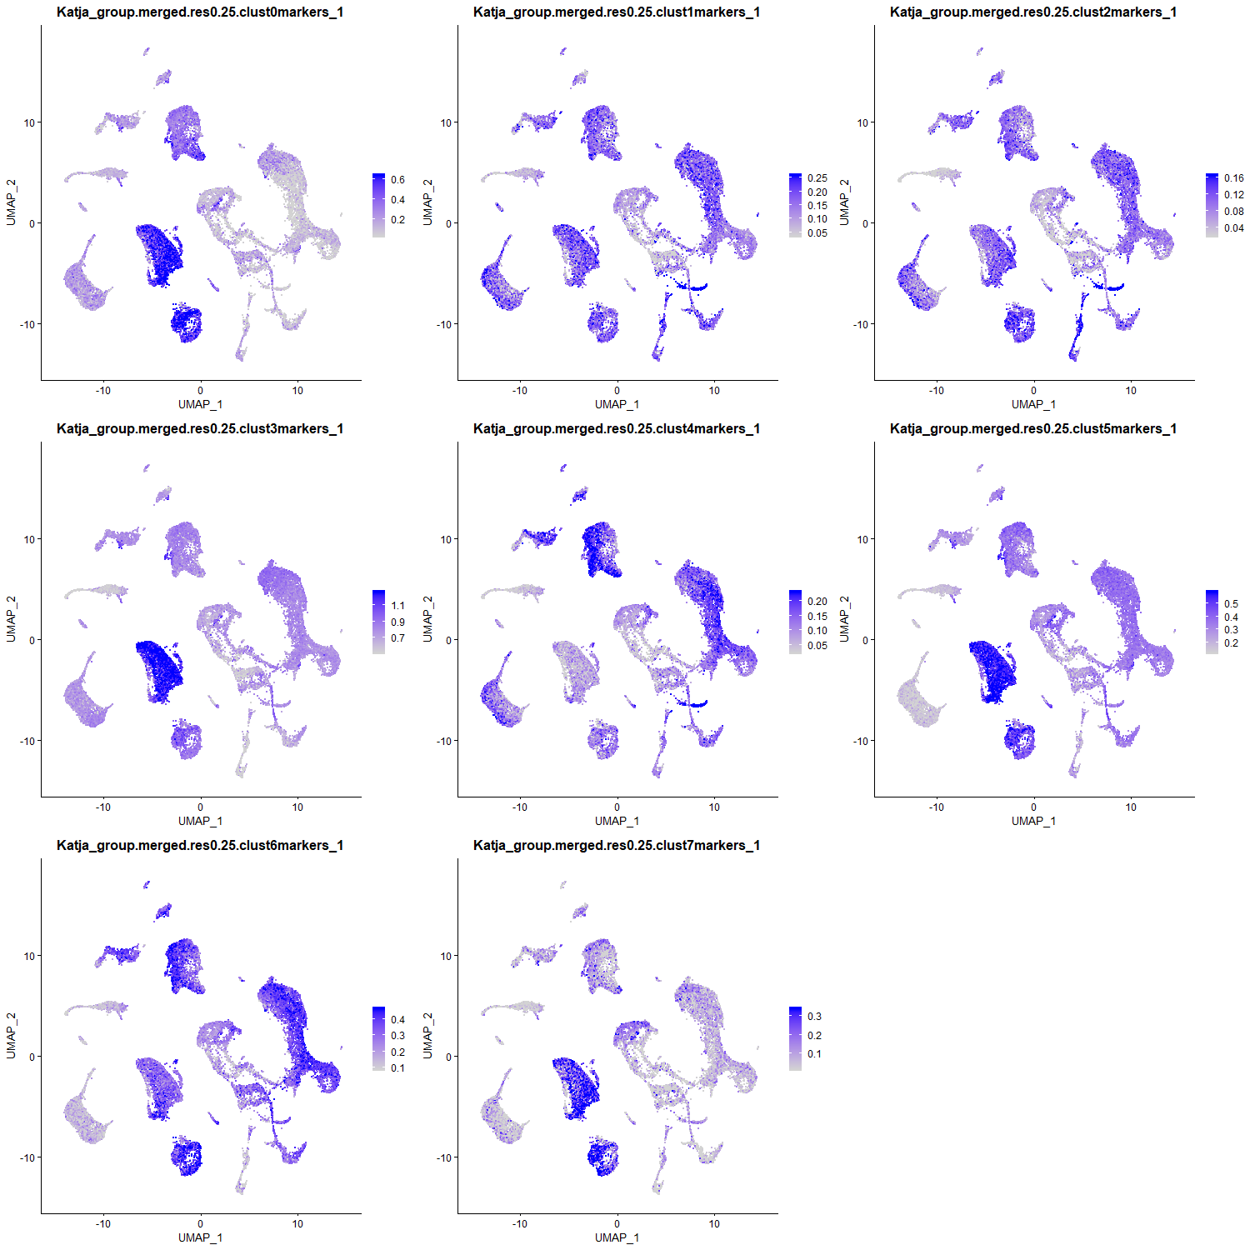
Score the in vitro cluster markers for ‘module activity’ in vivo
Cluster 0 markers
Immune (non-B, non-T)
Cluster 1 markers
Pericyte
Basal
3 clusters (resolution 0.05)
Cluster 2 markers
FB/stromal
SMC
Cycling cells
! Cell type annotations are preliminary
Score the in vitro cluster markers for ‘module activity’ in vivo
8 clusters (resolution 0.25)

Slide 11
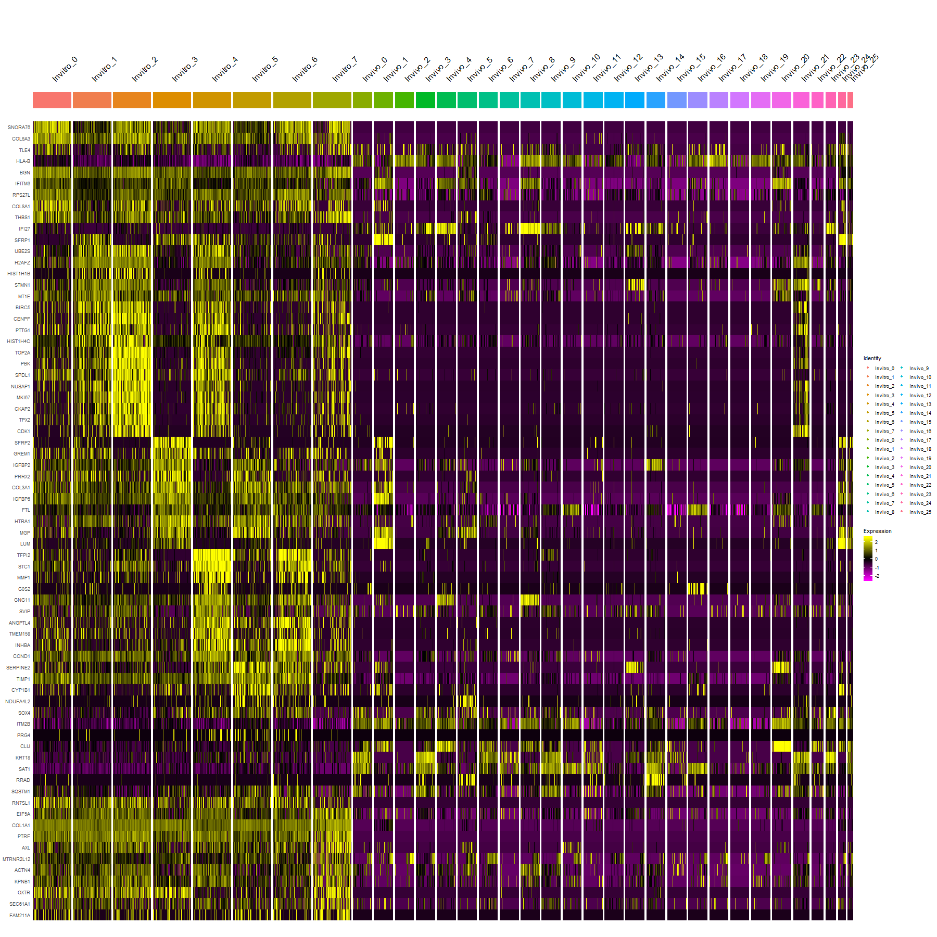
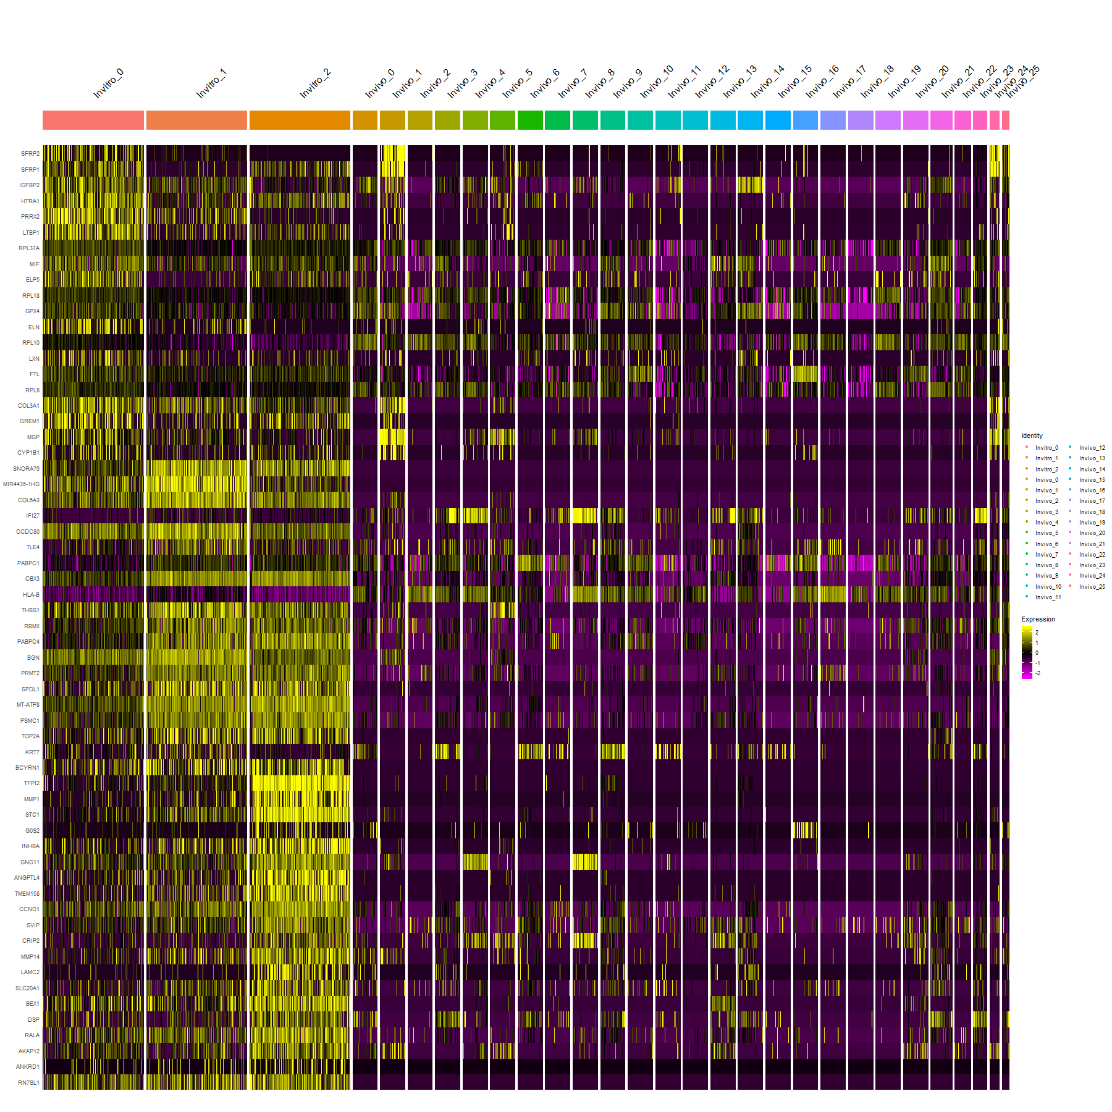
The issue
In vitro cell clusters
In vivo cell clusters
The in vitro dataset has low heterogeneity
→ the markers distinguishing the in vitro clusters aren’t really cell type-specific or highly expressed in vivo
8 clusters (resolution 0.25)
The issue
The in vitro dataset has low heterogeneity
→ the markers distinguishing the in vitro clusters aren’t really cell type-specific or highly expressed in vivo
In vitro cell clusters
In vivo cell clusters
3 clusters (resolution 0.05)

Slide 12
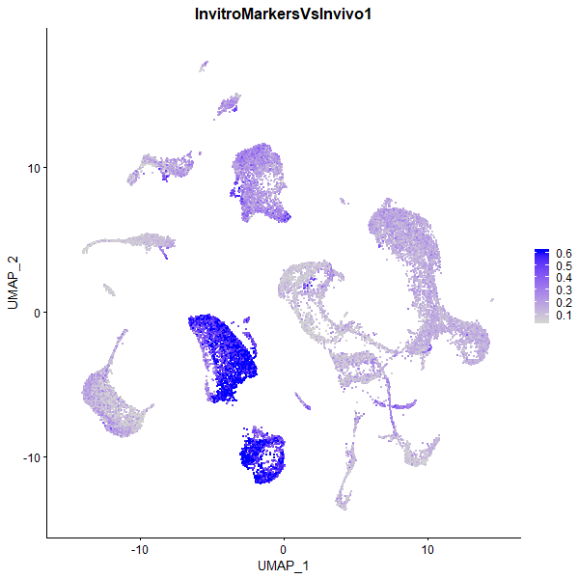
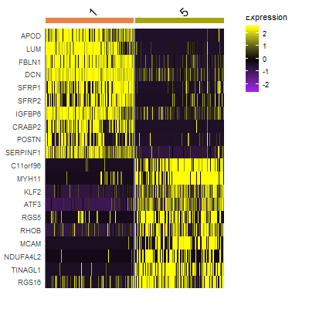
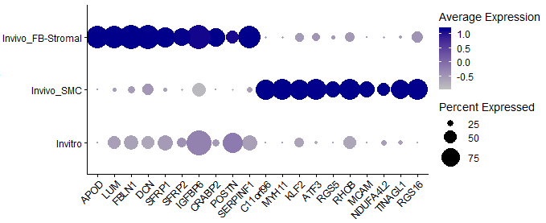
Gene set expression (‘module activity’)
Markers of all in vitro together vs all in vivo (same markers as on the previous 2 slides): 161 markers with l2FC>1 and padj<0.05
The expression of these genes is concentrated in the FB/stromal and the SMC populations.
Since the reference FB-s and SMC-s show similar levels, the result can be taken to mean that the top markers for the in vitro cells are not strongly enriched for either FB-specific or SMC-specific markers.
FB or SMC? Compare markers that distingiush them in vivo
Top distinguishing genes:
In vivo FB/Stromal
In vivo
SMC
FB/Stromal
markers
SMC
markers

Slide 13
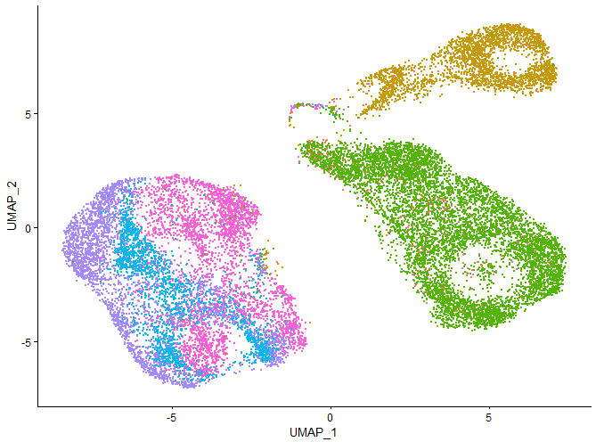
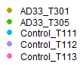
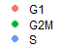
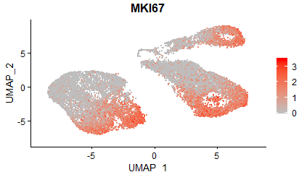
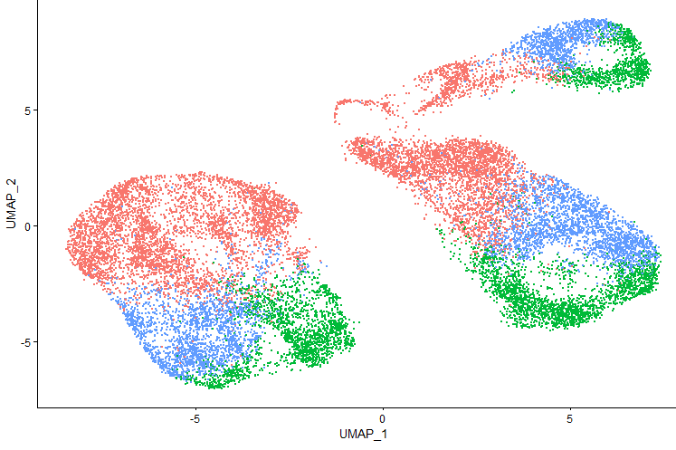
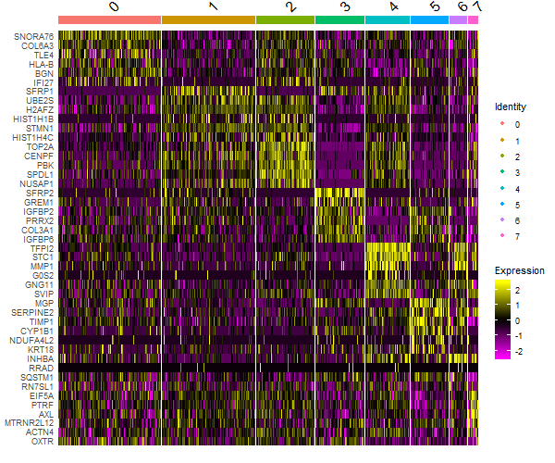
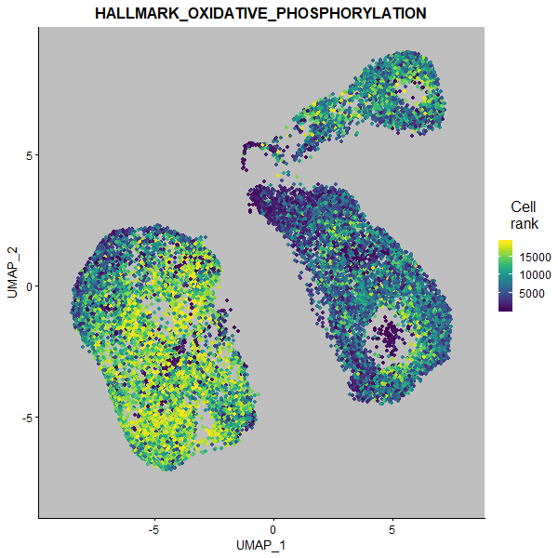
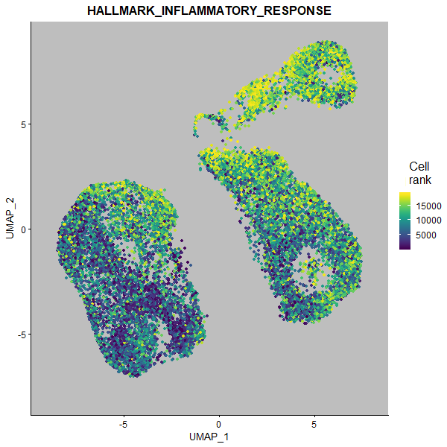
Fig. X. Composition of hOM cultures analyzed by scRNA-Seq
A: UMAP plot of single cells colored by donor and disease state.
The cells from non-AD donors are localized together, and are separated from the cell originating from donors with AD.
A
C
AD donors
Control donors
B: Within each of the three main populations, cells localize mostly by cell cycle phase.
Cell cycle phase prediction results
Expression of the MKI67, a classical marker of cells currently in cell cycle
B
Phase
MKI67
expression
D
F
Oxidative phosphorylation
C: automated clustering
D: heatmap of the top marker genes for each cluster from panel C
E: example UMAP plots showing genes the are cluster specific in D
F: Examples of functional profiling categories showing differential activity by disease state
Inflammatory response
[optional: some example UMAP plots showing genes the are cluster specific in D (similarly to how MKI67 supports the Phase in panel B)]

Slide 14
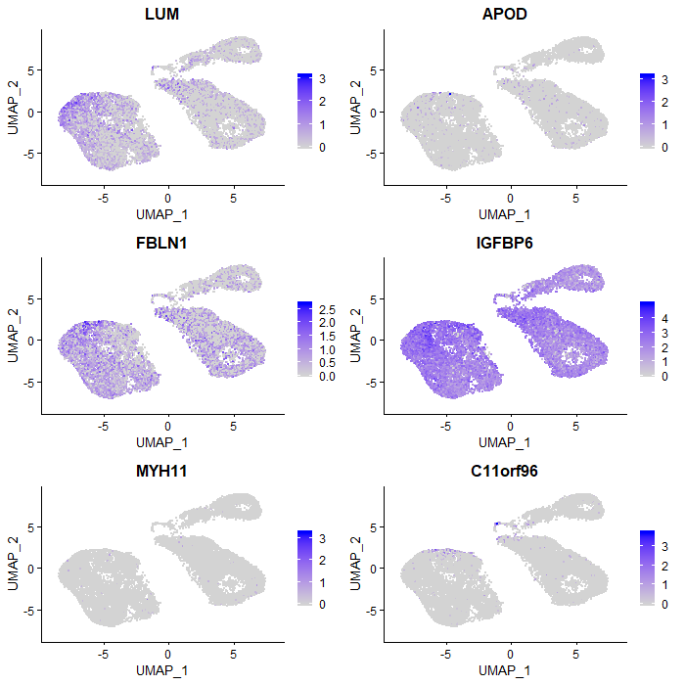
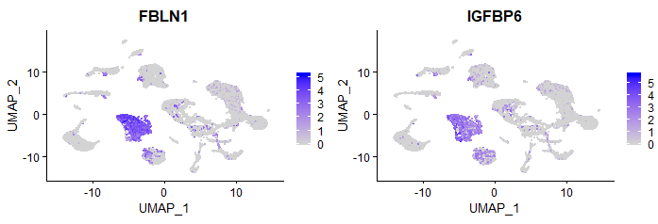
Fig. X. Comparison of hOM cultures to freshly samples hOM scRNA-Seq published by Durante et al 2020
A: cell type annotation freshly isolated hOM cells as the reference populations.
Note: for a final figure, should switch numbers to cell type names
Almost all cultured cells are predicted to be FB/Stromal (cluster 1 in vivo), and a few also SMC (cluster 5). This is probably related to the myofibroblast-like component of these in vitro transcriptomes
A
Reference cell populations
(Durante 2020 data)
Cell type prediction
D
Immune (non-B, non-T)
hOM cultured
Pericyte
Basal
FB/stromal
1
SMC
5
B: top markers for distinguishing FB and SMC in cells from fresh hOM tissue, plotted from fresh and cultured cells
Shows that the cultured cells tend to express the FB-specific markers
B
FB/Stromal
markers
SMC
markers
C: Heatmap comparing in vivo cell population markers to the hOM culture cells.
The in vitro cells express markers of:
Cluster 1 (FB/stromal)
Cluster 5 (SMC)
Cluster 8 (Pericytes)
Cell cycle genes (Cluster 13 and 21)
Some likely doublet clusters (cluster 24 and 25)
➔ fibrogenic and myocyte-related cells
➔ in general agreement with
cell type prediction from in vivo reference
the Alona automated cell type prediction tool
Note: we can make it more readable by having less in vivo populations (e.g., combining the ~3 basal cell clusters into 1)
C
In vivo cell populations
hOM fresh
FB/stromal
FB/stromal
D: Uniform expression of FB/Stromal markers in the cultured cells. For comparison, the same markers are plotted from the Durante 2020 hOM data.

